Slide 1
SEMI-AUTO CHEMISTRY ANALYSER
EB_1.0_CORE_V_1.0 BOARD PERIPHERAL CONNECTION DETAILS – PHOTOMETER

Slide 2
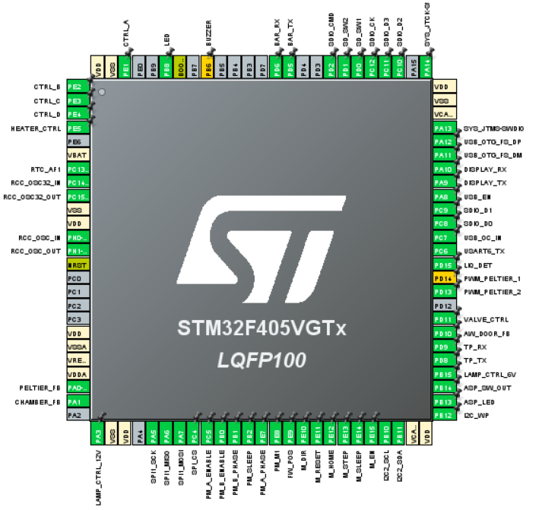
STM32F405VGT Pin out

Slide 3
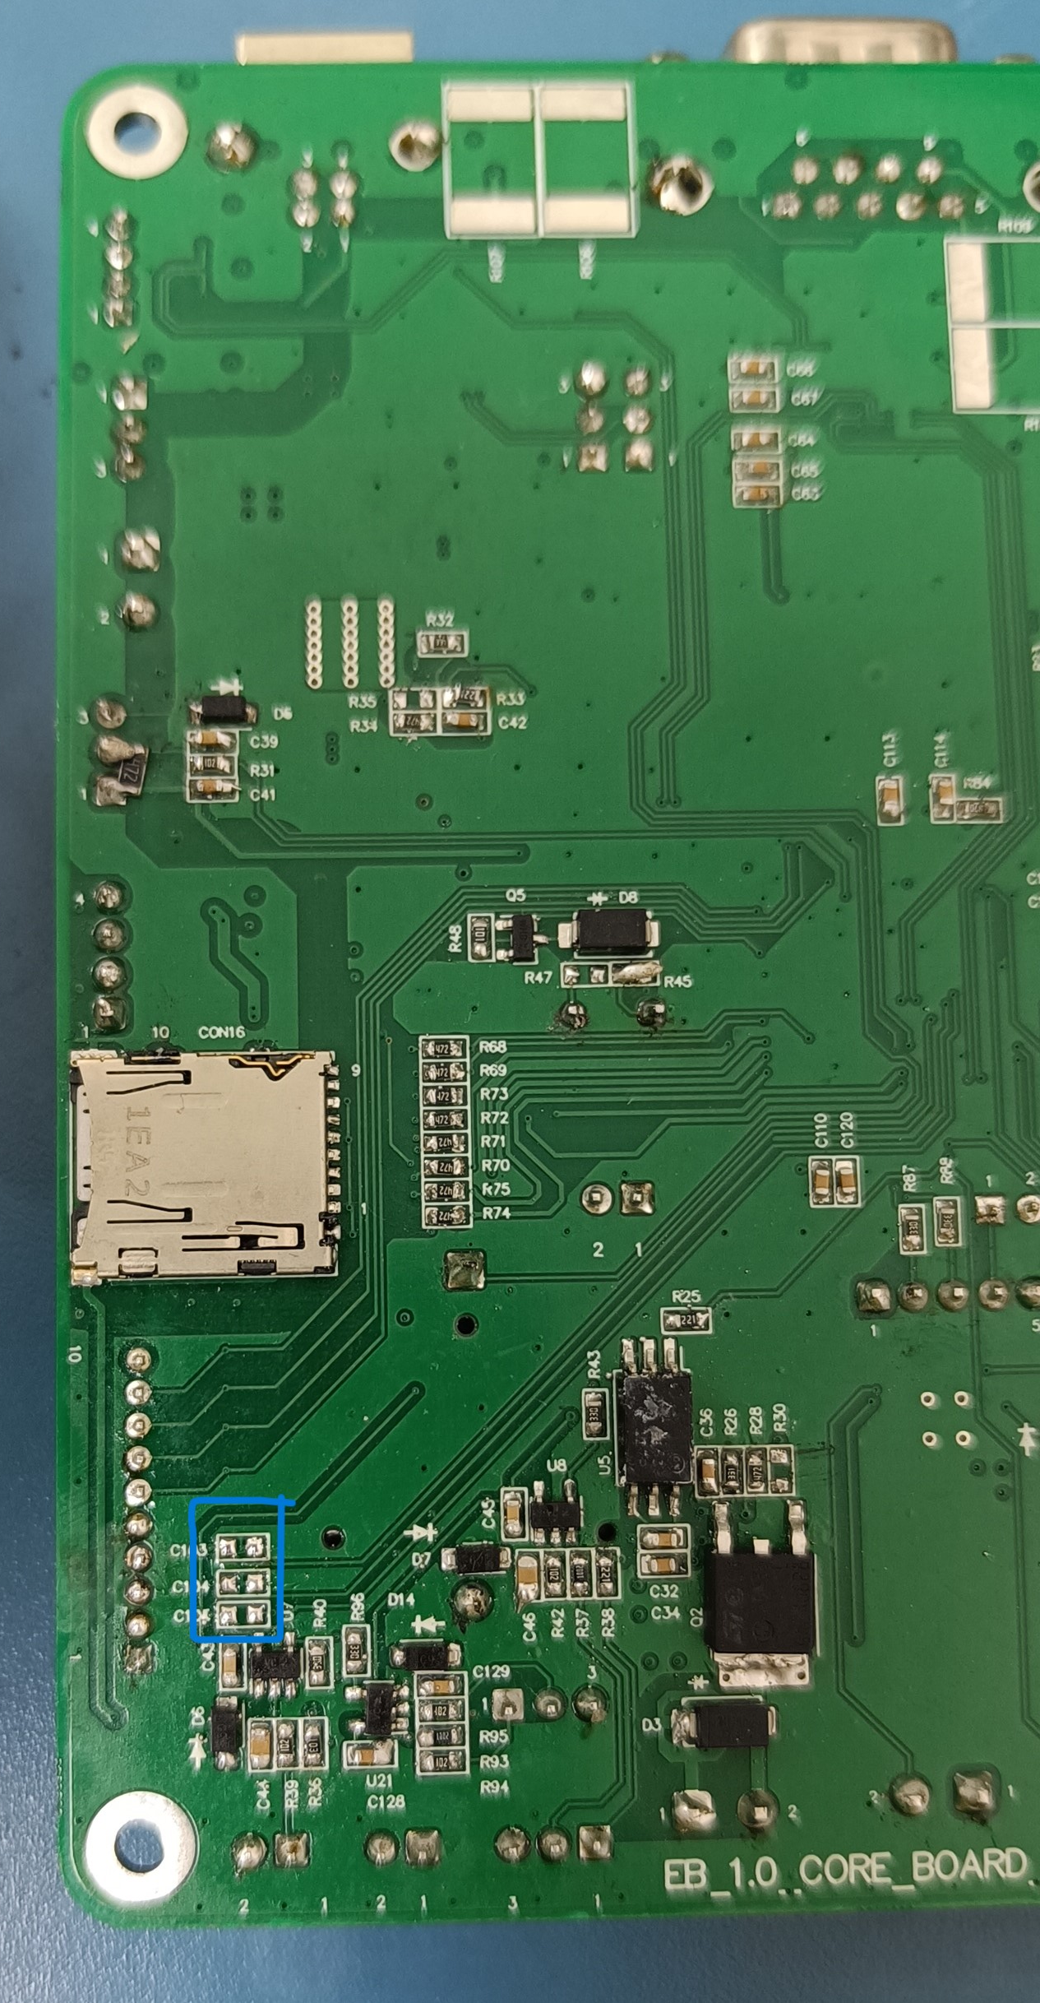
Hardware changes needs to be done before starting the device driver
Please remove(De-soldering) the capacitor from board
same as marked area in the ref image.
C104
C105
C106

Slide 4
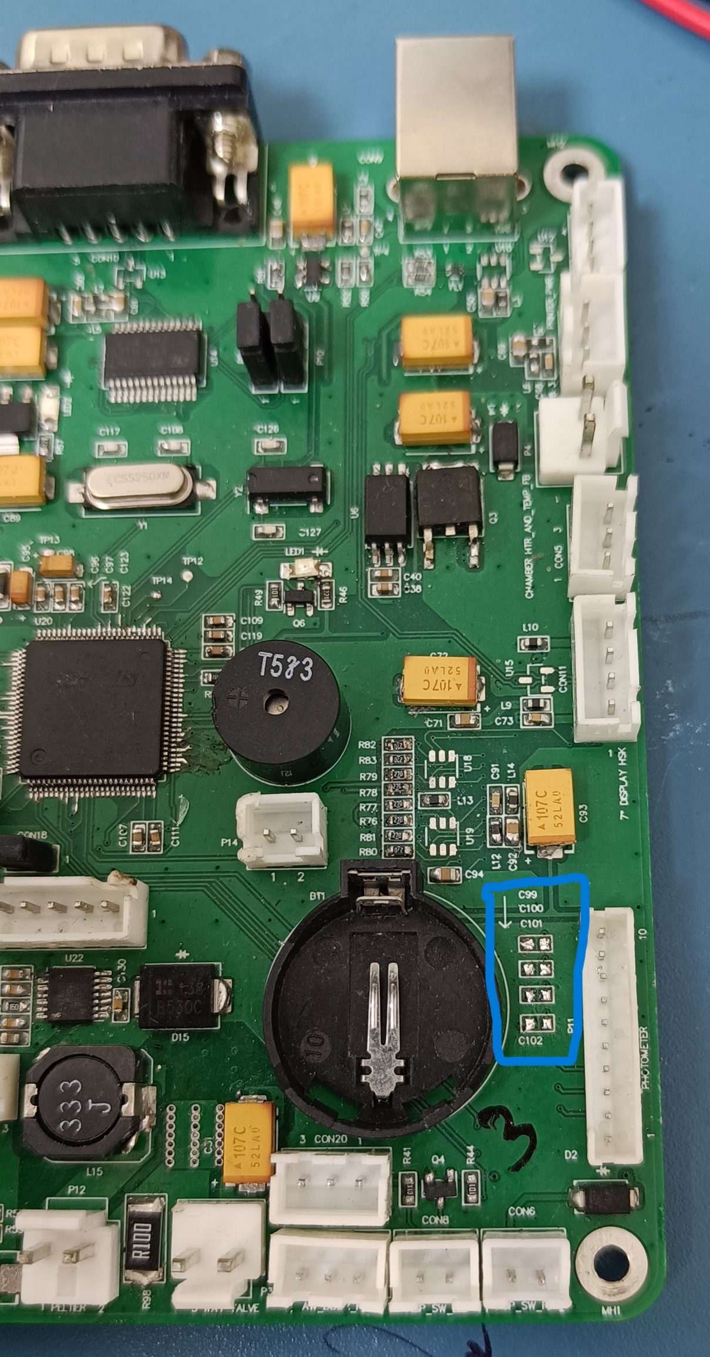
Hardware changes needs to be done before starting the device driver
Please remove(De-soldering) the capacitor from board
same as marked area in the ref image.
C99
C100
C101
C102

Slide 5
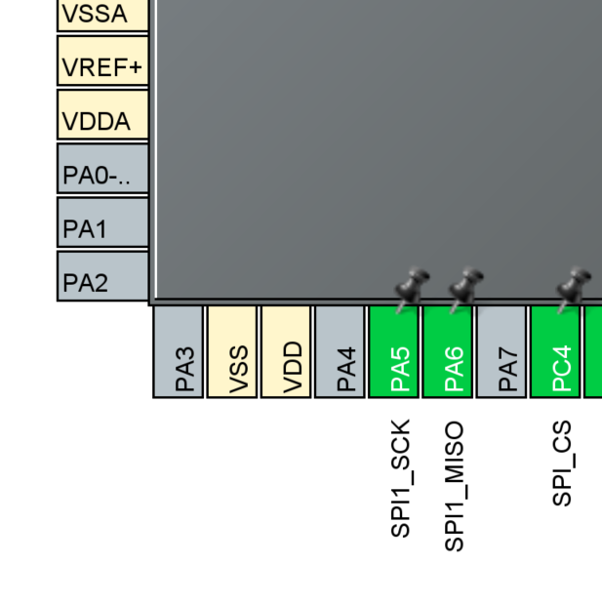
Photometer to Core board (COM)
SPI Receive only master mode

Slide 6
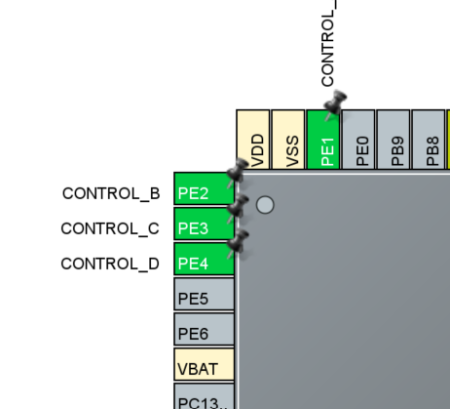
Photometer configuration - Gain selection
Control A
Control B
Control C
Control D are 4 different type of gain
To select the gain, set the pin in high state

Slide 7
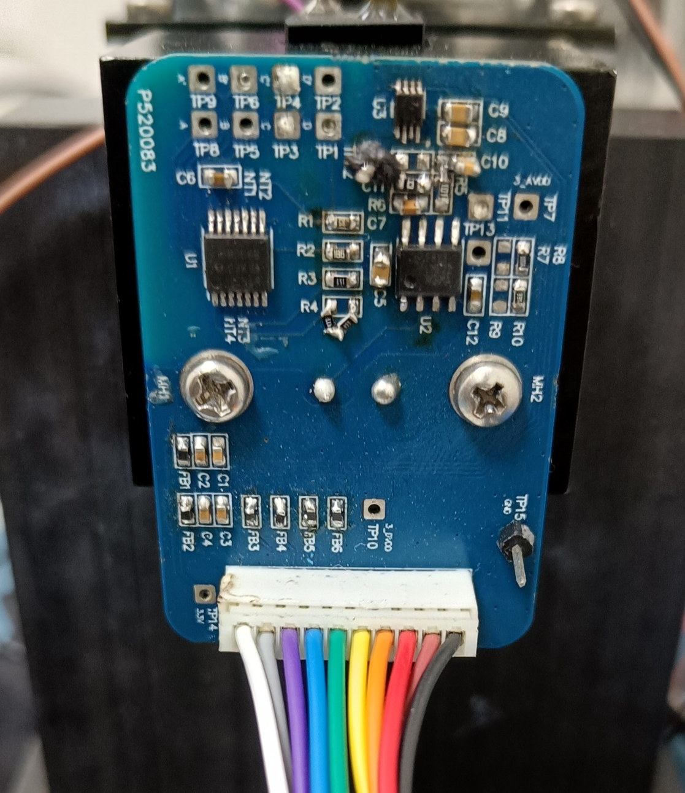
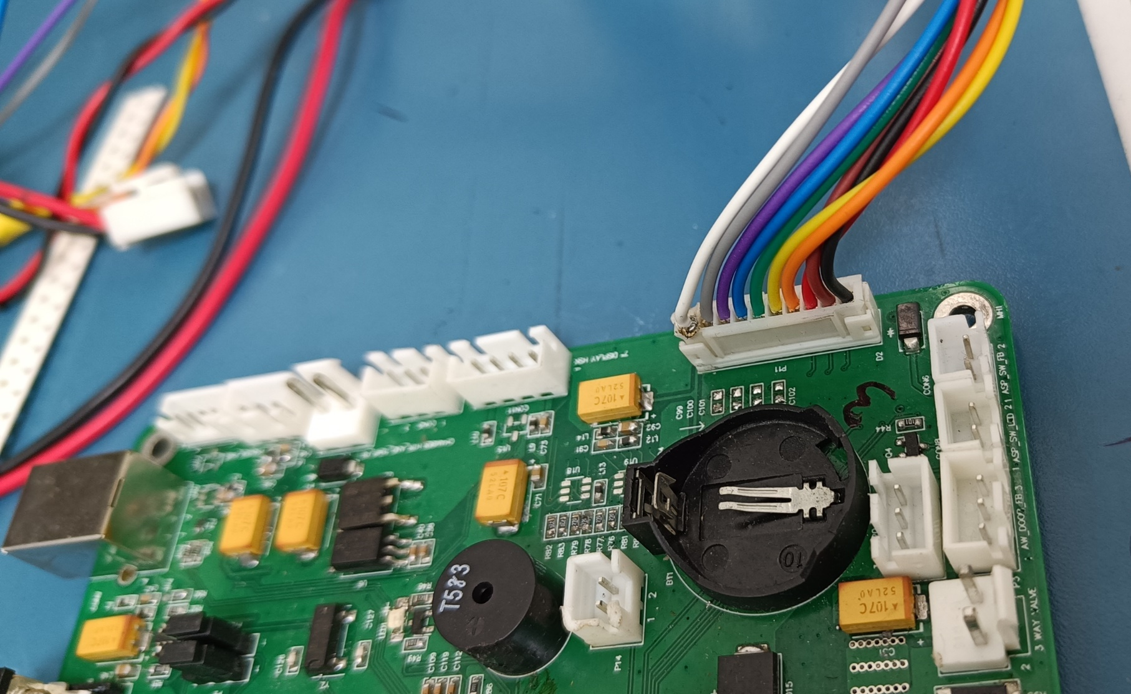
Photometer connection
Connect 10pin jst cable one end in core board connector P11 and another end in photometer board same as in the ref image.

Slide 8
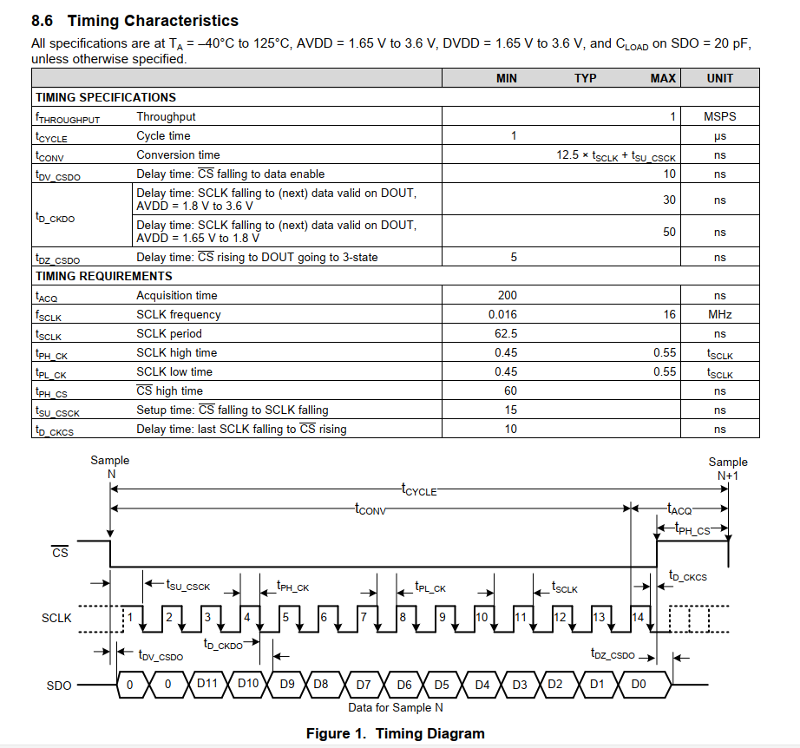
SAR-ADC timing diagram

